Slide 1


FY25 Budget Approval Meeting

Slide 2
Norms
This is a meeting of the GO Team. Only members of the team may participate in the discussion. Any members of the public present are here to quietly observe.
We will follow the agenda as noticed to the public and stay on task.
We invite and welcome contributions of every member and listen to each other.
We will respect all ideas and assume good intentions.

Slide 3
Agenda
Action Items
  Approval of Agenda
  Approval of Previous Minutes
  Budget Approval (after final presentation/review and discussion)
Discussion Items
  Presentation of the final budget
  Security Grant Survey
Information Items
  Principal’s Report
    SOSA/Literacy Night
Announcements
  Complete EOY GO Team Surveys

Slide 4

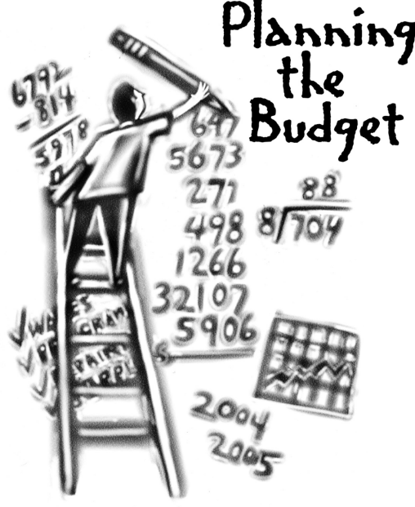
Overview of FY ‘25 GO Team Budget Process
Step 1 Review and Update Strategic Plan and Rank Strategic Priorities
By end of Fall Semester
Step 6 Principals: HR Staffing Conferences Begin
Late February – Early March
Step 3 GO Team Initial Budget Session: Allocation
January 17– early February
Step 7 GO Team Final Budget Approval Meeting
Budgets Approved by March 15
Step 5
GO Team Feedback Session: Draft Budget Presented & Discussed
February – multiple meetings, if necessary
Step 4 Principals: Associate Supt. Discussions and Review
February (supports needed, specific challenges, coaching)
Step 2 Principals: Workshop FY 25 Budget
January 17, 2024
GO Teams are encouraged to have ongoing conversations throughout the year about the school’s budget.

Slide 5
Budget Approval Meeting
What
During this meeting GO Teams will review the budget, which should be updated based on feedback from the staffing conference, Associate Superintendents, and key leaders. After review, GO Teams will need to take action (i.e., vote) on the FY25 Budget.
Why
Principals will present the final budget recommendations for GO Team approval.
When
All approval meetings must be held after staffing conferences. Budgets must be approved by March 15th.

Slide 6
Budget Review

Slide 7

FY25 Budget Parameters
FY25 School Priorities | Rationale
Increase student performance in Math | About 60% of 3-5 students are not meeting mastery the standards as measured by MATH GMAS (proficient/distinguished)
Increase student performance in ELA | About 45% of 3-5 students are not meeting mastery the standards as measured by ELA GMAS (proficient/distinguished)
Embed a data-driven, multi-tiered system of support to improve our multi-lingual learner performance | We need to decrease the GAP of academic performance in our EL subgroups as measured by GMAS (proficient/distinguished)
Notes:
Review the priorities that the GO Team has developed and the rationale for these priorities. Feel free to copy this slide if you have more than 3 priorities to account for.

Slide 8
Descriptions of Strategic Plan
Breakout Categories
Priorities: FY25 funding priorities from the school’s strategic plan, ranked by the order of importance.
APS Five Focus Area: What part of the APS Five is the priority aligned to?
Strategies: Lays out specific objectives for school’s improvement.
Request: “The Ask” What needs to be funded in order to support the strategy?
Amount: What is the cost associated with the Request?

Slide 9
FY25 Strategic Plan Break-out
Priorities | APS FIVE Focus Area | Strategies | Requests | Amount
Increase level of rigor and relevance (example- please remove) | Fostering Academic Excellence for All (example- please remove) | Implementation of guided reading training for all staff (example- please remove) | Purchase an additional Teacher (example- please remove) | $84, 134 (example- please remove)
Increase performance in ELA and Math | Curriculum & Instruction Whole Chile | Decreasing Class Sizes | Add a 5th Grade Teacher | 106,000
Increase performance in Math | Curriculum & Instruction Data | Implementing Content specific instructional coaches | Change Master Teacher to Math Coach | Change of about 16,000
EXAMPLE
Notes:
For the next few slides, I will show you how I have allocated the budget to support our strategic priorities.
Based on our strategic priorities and funds we received, here is a break-out of the priorities, which focus area it addresses, the strategies that will be implemented, the purchase request, which funding source was used and the amount.

Slide 10
Summary of position Changes to Support the Strategic Plan
CREATED | REMOVED
5th Grade Teacher | n/a
Math Instructional Coach | DLI Master Teacher (16,000 difference)
Summary of Changes
Principals: Please provide a summary of the impact of these changes and how they relate to your strategic plan.

Slide 11

Staffing Conference Changes
Principals –indicate on this slide if there were any changes made to your budget proposal at your staffing conference. If there were no changes, please just cover the Budget by Function on slides 7 & 8 as a quick summary for your GO Team. If there were changes, please summarize for your team and then discuss the NEW Budget by Function values.
There were changes made to the draft budget we discussed at our last meeting.
These changes reflect an allocation change of $19,000 from the reserve fund.

Slide 12
Summary of Changes at
Staffing Conference
Change at Staffing Conference | Impact to Proposed Budget
Keep the Parent Liaison instead of abolish | $19,000 to the reserve

Slide 13
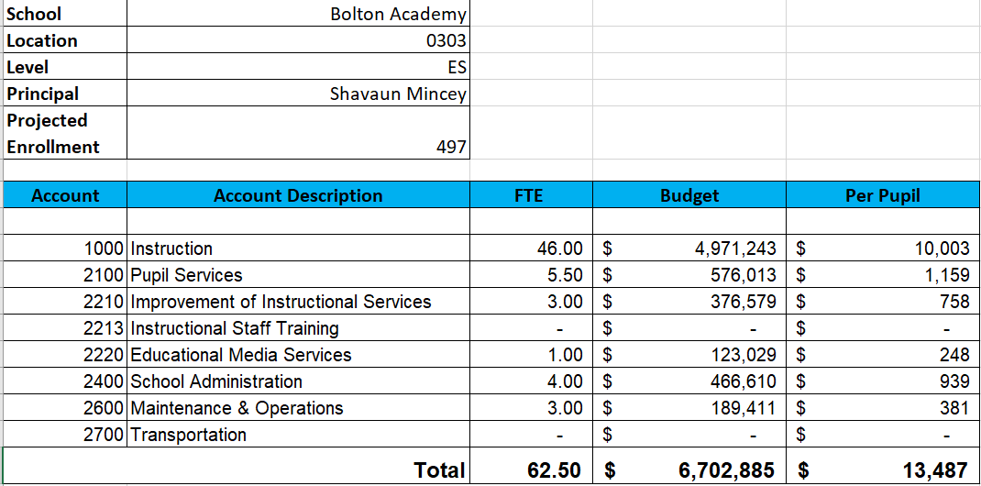
FY25 Budget by Function (Required)
*Based on Current Allocation of School Budget
Notes:
Look at the table to see what makes up each category. Although the school’s total budget amount will not change, allocation per function may change depending on our conversations and school needs.

Slide 14
FY25 Budget by Function (Required)
*Based on Current Allocation of School Budget
Notes:
Explain the pie chart and allocations

Slide 15
Discussion of reserve and Holdback funds

Slide 16
Plan for FY25 Leveling Reserve
$__(83,451)___
Priorities | APS FIVE Focus Area | Strategies | Requests | Amount
Increase student performance in Math | Curriculum & Instruction Personalized learning | Continue to use curriculum resources online for teachers and students | School Supplies, Incentives, Instructional Materials | $30,000
Increase student performance in ELA | Curriculum & Instruction | Training, Material, and Subs | Training and Subs | 25,451
Increase Attendance, Decrease Incidents | Whole Child | Bike Raffles Attendance Parties MAP Growth Celebrations Dojo Store | Student Incentives | 10,000
Notes:
For the next few slides, I will show you how I have allocated the budget to support our strategic priorities.
Based on our strategic priorities and funds we received, here is a break-out of the priorities, which focus area it addresses, the strategies that will be implemented, the purchase request, which funding source was used and the amount.

Slide 17
Questions for the GO Team to Consider and Discuss
Are our school’s priorities (from your strategic plan) reflected in this budget?
Are new positions and/or resources included in the budget to address our major priorities?
Do we know (as a team) the plan to support implementation of these priorities beyond the budget (ex. What strategies will be implemented)?
What tradeoffs are being made in order to support these priorities?
How are district and cluster priorities reflected in our budget?
Cluster priorities- what staff, materials, etc. are dedicated to supporting our cluster’s priorities?
Signature programs- what staff, materials, etc. are dedicated to supporting our signature program?
Are there positions our school will share with another school, e.g. nurse, counselor?
Notes:
CHAIR - Our final task for today! Here are questions that we need to consider to ensure we have a good working draft budget. Let’s walk through them together.

Slide 18

Questions?

Slide 19
The GO Team needs to TAKE ACTION (vote) on the presented budget. After the motion and a second, the GO Team may have additional discussion. Once discussion is concluded, the GO Team will vote.
Action on the Budget

Slide 20

Security Grant
Survey

Slide 21
Annoucements

Slide 22
Provide Your Feedback on the Final APS Student Calendar Survey
Atlanta Public Schools has used widespread community engagement to create two calendar options for the following school years: SY 25-26, SY 26-27, and SY 27-28.
Your feedback through this survey is valuable and will be another important piece of information that the Superintendent and the APS School Board of Education will use to make a final decision about our future school calendars.
HOW: Scan the QR code or click the link for a quick survey.
WHO: All stakeholders, including students, staff, families,
and community members.
WHEN: Open from Mon, February 19th to Fri, March 15th
https://survey.co1.qualtrics.com/jfe/form/SV_0VrymDxIIaygE9E
To learn more about the APS Student Calendar development process, visit https://www.atlantapublicschools.us/Page/71713

Slide 23
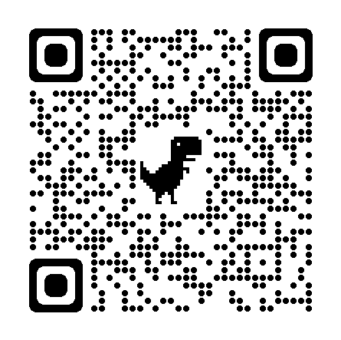
Comparta su opinión en la encuesta final del Calendario Escolar de APS
Basándose en la participación de la comunidad en general, Atlanta Public Schools ha elaborado dos opciones de calendario para los próximos años escolares: 2025-2026, 2026-2027 y 2027-2028.
Su opinión en esta encuesta cuenta y será un factor más que la Superintendente y la Junta de Educación de APS considerarán al momento de tomar la decisión final sobre los calendarios escolares futuros.
CÓMO: Escanee el Código QR o haga clic en el enlace para completar una breve
encuesta.
QUIÉN: Todas las partes interesadas, incluidos alumnos, personal escolar,
familias y miembros de la comunidad.
CUÁNDO: abierta desde el lunes 19 de febrero hasta el viernes
15 de marzo
https://survey.co1.qualtrics.com/jfe/form/SV_cAqsxuT3U5nNu0m?Q_lang=ES
Para más información sobre el proceso de desarrollo del Calendario Escolar para Estudiantes de APS, visite: https://www.atlantapublicschools.us/Page/71713

Slide 24
GO Team members remember to:
  Complete your required trainings
    Orientation
    Ethics
    Budget
  Complete the end of year surveys (check your email for the links)
    GO Team Self-Assessment
    Principal Feedback

Slide 25
Questions?

Slide 26

Thank you

